Slide 1
PELOPONNESIAN WAR
SEM-I
CC-II
MOUSUMI ROYCHOUDHURY

Slide 2
The Peloponnesian War (431–404 BC) was an ancient Greek war fought by the Delian League led by Athens against the Peloponnesian League led by Sparta. Historians have traditionally divided the war into three phases. In the first phase, the Archidamian War, Sparta launched repeated

Slide 3
invasions of Attica, while Athens took advantage of its naval supremacy to raid the coast of the Peloponnese and attempt to suppress signs of unrest in its empire. This period of the war was concluded in 421 BC, with the signing of the Peace of Nicias. That treaty, however, was soon undermined by renewed fighting in the Peloponnese

Slide 4
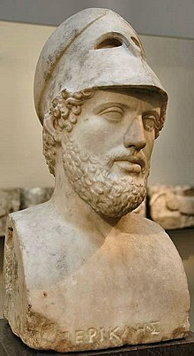
Pericles

Slide 5
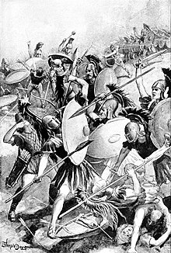
Destruction of the Athenian army

Slide 6
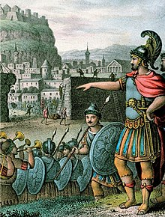
Lysander outside the walls of Athens. 19th century

Slide 7
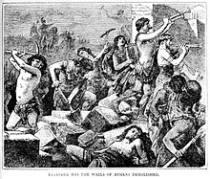
The Spartan general Lysander has the walls of Athens demolished in 404 BC, as a result of the Athenian defeat in the Peloponnesian Wa

Slide 8
Peace of Nicias (421 BC)
The Peace of Nicias, also known as the Fifty-Year Peace, was a peace treaty signed between the Greek city-states of Athens and Sparta in March 421 BC, ending the first half of the Peloponnesian War.

Slide 9
Sicilian Expedition
Sicilian Expedition
The Sicilian Expedition was an Athenian military expedition to Sicily, which took place 415–413 BC during the Peloponnesian War between the Athenian empire on one side and Sparta, Syracuse and Corinth on the other. The expedition ended in a devastating defeat of the Athenian forces

Slide 10
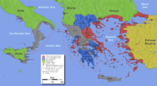
Sicily and the Peloponnesian War

Slide 11
Thank You

